Slide 1
Applied Cryptography CBC-MAC, birthday chosen message attack, nested MAC, HMAC encrypt-then-MAC, unconditionally secure MAC
Liangfeng Zhang
School of Information Science and Technology
ShanghaiTech University

Slide 2
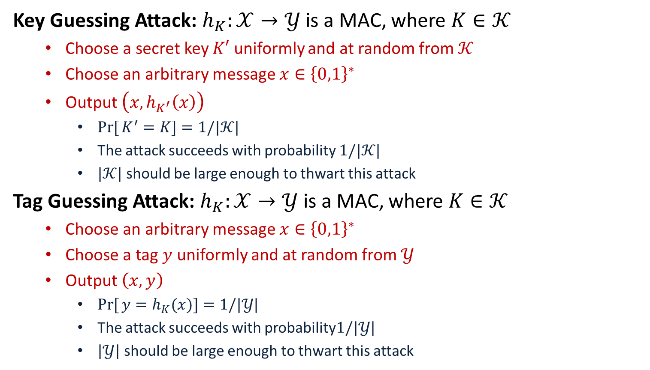
Two Attacks
Key Guessing Attack: $h_{K}:𝒳→𝒴$ is a MAC, where $K∈𝒦$
Choose a secret key $K′$ uniformly and at random from $𝒦$
Choose an arbitrary message $x∈{\left\{0,1\right\}}^{∗}$
Output $\left(x,h_{K^{′}}\left(x\right)\right)$
$\operatorname{Pr}{[}K^{′}=K]=1/|𝒦|$
The attack succeeds with probability $1/|𝒦|$
$|𝒦|$ should be large enough to thwart this attack
Tag Guessing Attack: $h_{K}:𝒳→𝒴$ is a MAC, where $K∈𝒦$
Choose an arbitrary message $x∈{\left\{0,1\right\}}^{∗}$
Choose a tag $y$ uniformly and at random from $𝒴$
Output $\left(x,y\right)$
$\operatorname{Pr}{[}y=h_{K}(x)]=1/|𝒴|$
The attack succeeds with probability$1/|𝒴|$
$|𝒴|$ should be large enough to thwart this attack

Slide 3


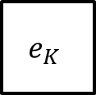





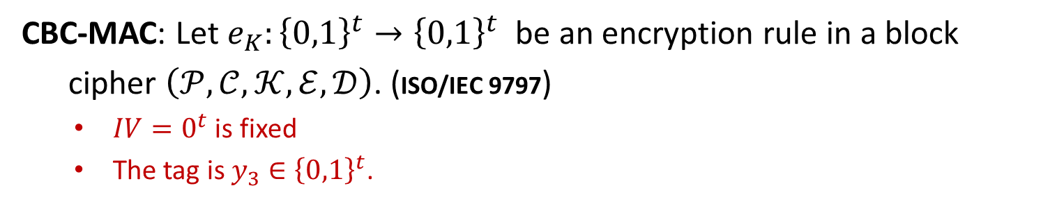

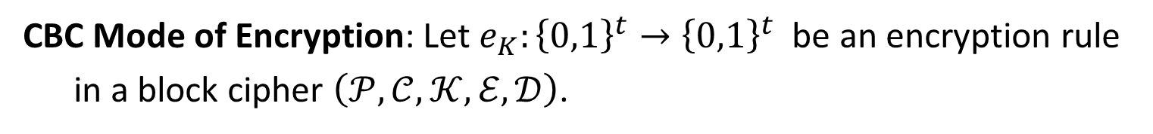











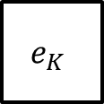






CBC-MAC
CBC Mode of Encryption: Let $e_{K}:{\left\{0,1\right\}}^{t}→{\left\{0,1\right\}}^{t}$ be an encryption rule
in a block cipher $\left(𝒫,𝒞,𝒦,ℰ,𝒟\right)$.
$$x_{1}$$
$$x_{2}$$
$$x_{3}$$
$$x_{1}$$
$$x_{2}$$
$$x_{3}$$
$$IV$$
$$⨁$$
$$⨁$$
$$⨁$$
$$IV$$
$$⨁$$
$$⨁$$
$$⨁$$
$$e_{K}$$
$$e_{K}$$
$$e_{K}$$
$$e_{K}$$
$$e_{K}$$
$$e_{K}$$
$$y_{1}$$
$$y_{2}$$
$$IV$$
$$y_{1}$$
$$y_{2}$$
$$y_{3}$$
$$y_{3}$$
CBC Encryption: $(x_{1},x_{2},x_{3})↦(IV, y_{1},y_{2},y_{3})$
CBC-MAC: $(x_{1},x_{2},x_{3})↦y_{3}$
CBC-MAC: Let $e_{K}:{\left\{0,1\right\}}^{t}→{\left\{0,1\right\}}^{t}$ be an encryption rule in a block
cipher $\left(𝒫,𝒞,𝒦,ℰ,𝒟\right)$. ($\text{ISO}\text{/}\text{IEC}\text{ 9797}$)
$IV=0^{t}$ is fixed
The tag is $y_{3}∈{\left\{0,1\right\}}^{t}$.

Slide 4




















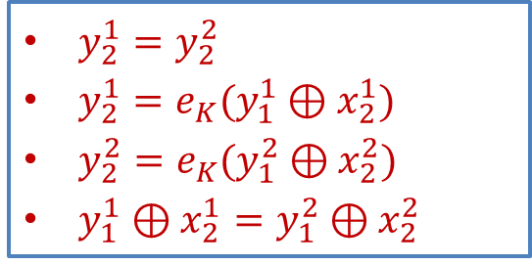







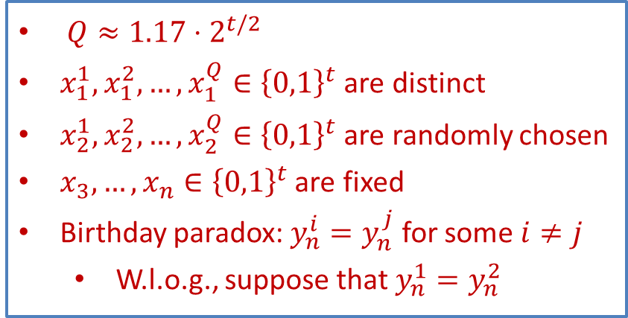









Security of CBC-MAC
Birthday Chosen Message Attack: for messages of length $n≥3$
$$x^{1}$$
$$x_{1}^{1}$$
$$x_{2}^{1}$$
$$x_{3}$$
$$⋯$$
$$x_{n}$$
$$→$$
$$y_{0}^{1},y_{1}^{1},y_{2}^{1},y_{3}^{1},…,y_{n}^{1}$$
$$x^{2}$$
$$x_{1}^{2}$$
$$x_{2}^{2}$$
$$x_{3}$$
$$⋯$$
$$x_{n}$$
$$→$$
$$y_{0}^{2},y_{1}^{2},y_{2}^{2},y_{3}^{2},…,y_{n}^{2}$$
$$x^{3}$$
$$x_{1}^{3}$$
$$x_{2}^{3}$$
$$x_{3}$$
$$⋯$$
$$x_{n}$$
$$→$$
$$y_{0}^{3},y_{1}^{3},y_{2}^{3},y_{3}^{3},…,y_{n}^{3}$$
$$⋮$$
$$⋮$$
$$⋮$$
$$⋮$$
$$⋯$$
$$⋮$$
$$⋮$$
$$⋮$$
$$x^{Q}$$
$$x_{1}^{Q}$$
$$x_{2}^{Q}$$
$$x_{3}$$
$$⋯$$
$$x_{n}$$
$$→$$
$$y_{0}^{Q},y_{1}^{Q},y_{2}^{Q},y_{3}^{Q},…,y_{n}^{Q}$$
$Q≈1.17⋅2^{t/2}$
$x_{1}^{1},x_{1}^{2},…,x_{1}^{Q}∈{\left\{0,1\right\}}^{t}$ are distinct
$x_{2}^{1},x_{2}^{2},…,x_{2}^{Q}∈{\left\{0,1\right\}}^{t}$ are randomly chosen
$x_{3},…,x_{n}∈{\left\{0,1\right\}}^{t}$ are fixed
Birthday paradox: $y_{n}^{i}=y_{n}^{j}$ for some $i≠j$
W.l.o.g., suppose that $y_{n}^{1}=y_{n}^{2}$
CBC-MAC
tags
$y_{2}^{1}=y_{2}^{2}$
$y_{2}^{1}=e_{K}(y_{1}^{1}⊕x_{2}^{1})$
$y_{2}^{2}=e_{K}(y_{1}^{2}⊕x_{2}^{2})$
$y_{1}^{1}⊕x_{2}^{1}=y_{1}^{2}⊕x_{2}^{2}$

Slide 5

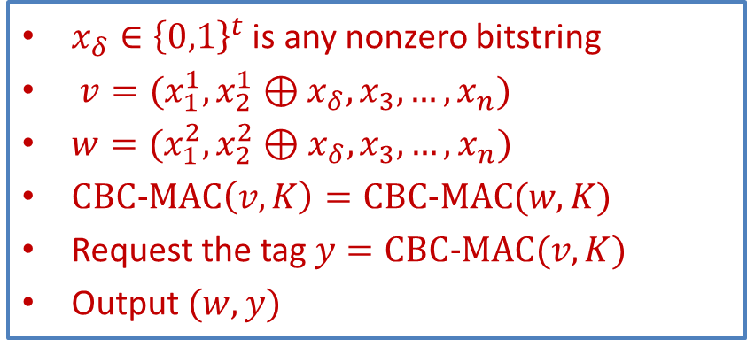
Security of CBC-MAC
Birthday Chosen Message Attack: for messages of length $n≥3$
$$x^{1}$$
$$x_{1}^{1}$$
$$x_{2}^{1}$$
$$x_{3}$$
$$⋯$$
$$x_{n}$$
$$→$$
$$y_{0}^{1},y_{1}^{1},y_{2}^{1},y_{3}^{1},…,y_{n}^{1}$$
$$x^{2}$$
$$x_{1}^{2}$$
$$x_{2}^{2}$$
$$x_{3}$$
$$⋯$$
$$x_{n}$$
$$→$$
$$y_{0}^{2},y_{1}^{2},y_{2}^{2},y_{3}^{2},…,y_{n}^{2}$$
$$x^{3}$$
$$x_{1}^{3}$$
$$x_{2}^{3}$$
$$x_{3}$$
$$⋯$$
$$x_{n}$$
$$→$$
$$y_{0}^{3},y_{1}^{3},y_{2}^{3},y_{3}^{3},…,y_{n}^{3}$$
$$⋮$$
$$⋮$$
$$⋮$$
$$⋮$$
$$⋯$$
$$⋮$$
$$⋮$$
$$⋮$$
$$x^{Q}$$
$$x_{1}^{Q}$$
$$x_{2}^{Q}$$
$$x_{3}$$
$$⋯$$
$$x_{n}$$
$$→$$
$$y_{0}^{Q},y_{1}^{Q},y_{2}^{Q},y_{3}^{Q},…,y_{n}^{Q}$$
$x_{δ}∈{\left\{0,1\right\}}^{t}$ is any nonzero bitstring
$v=(x_{1}^{1},x_{2}^{1}⊕x_{δ}, x_{3},…,x_{n})$
$w=(x_{1}^{2},x_{2}^{2}⊕x_{δ}, x_{3},…,x_{n})$
$CBC−MAC\left(v,K\right)=CBC−MAC(w,K)$
Request the tag $y=CBC−MAC(v,K)$
Output $(w,y)$
CBC-MAC
tags
$y_{2}^{1}=y_{2}^{2}$
$y_{2}^{1}=e_{K}(y_{1}^{1}⊕x_{2}^{1})$
$y_{2}^{2}=e_{K}(y_{1}^{2}⊕x_{2}^{2})$
$y_{1}^{1}⊕x_{2}^{1}=y_{1}^{2}⊕x_{2}^{2}$
$(1/2,O(2^{t/2}))$-forger

Slide 7
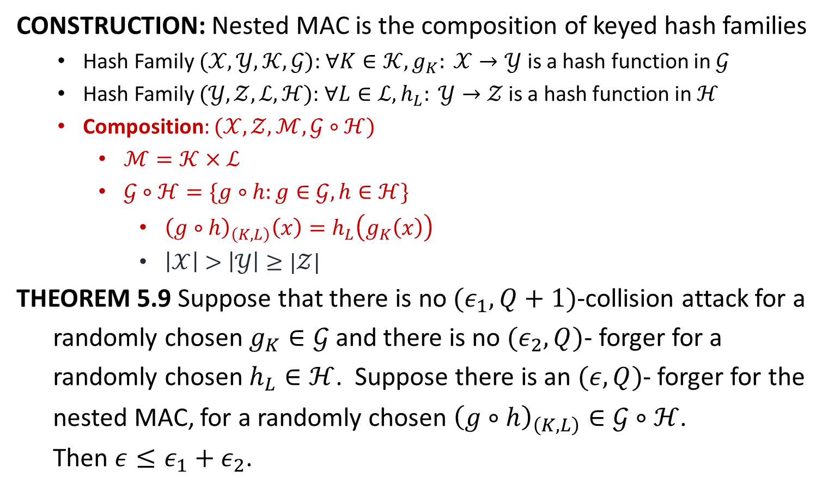
Nested MAC
CONSTRUCTION: Nested MAC is the composition of keyed hash families
Hash Family $(𝒳,𝒴,𝒦,𝒢)$: $∀K∈𝒦, g_{K}: 𝒳→𝒴$ is a hash function in $𝒢$
Hash Family $(𝒴,𝒵,ℒ,ℋ)\text{: }∀L∈ℒ, h_{L}: 𝒴→𝒵 \text{is} \text{a} \text{hash} \text{function} \text{in} ℋ$
Composition: $(𝒳,𝒵,ℳ,𝒢∘ℋ)$
$ℳ=𝒦×ℒ$
$𝒢∘ℋ=\{g∘h:g∈𝒢, h∈ℋ\}$
${\left(g∘h\right)}_{\left(K,L\right)}\left(x\right)=h_{L}\left(g_{K}\left(x\right)\right)$
$\left|𝒳\right|>\left|𝒴\right|≥|𝒵|$
THEOREM 5.9 Suppose that there is no $(ε_{1},Q+1)$-collision attack for a
randomly chosen $g_{K}∈𝒢$ and there is no $(ε_{2},Q)$- forger for a
randomly chosen $h_{L}∈ℋ$. Suppose there is an $(ε,Q)$- forger for the
nested MAC, for a randomly chosen ${\left(g∘h\right)}_{\left(K,L\right)}∈𝒢∘ℋ$.
Then $ε≤ε_{1}+ε_{2}$.

Slide 8
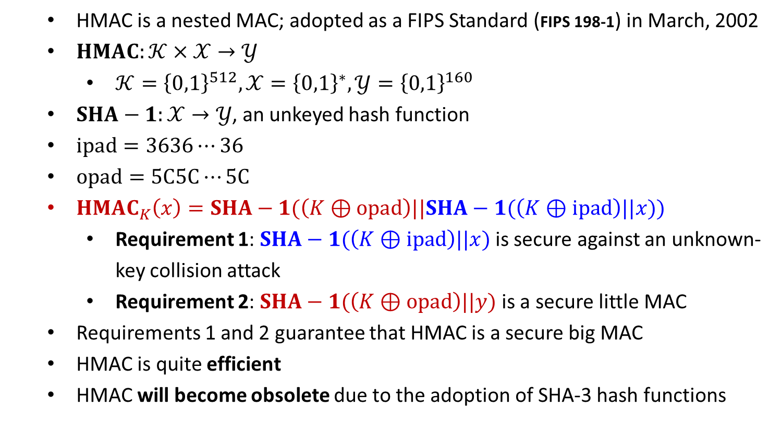
HMAC
HMAC is a nested MAC; adopted as a FIPS Standard (FIPS 198-1) in March, 2002
$HMAC:𝒦×𝒳→𝒴$
$𝒦={\left\{0,1\right\}}^{512}, 𝒳={\left\{0,1\right\}}^{∗}, 𝒴={\left\{0,1\right\}}^{160}$
$SHA−1:𝒳→𝒴$, an unkeyed hash function
$ipad=3636⋯36$
$opad=5C5C⋯5C$
$HMAC_{K}\left(x\right)=SHA−1(\left(K⊕opad\right)||SHA−1(\left(K⊕ipad\right)||x))$
Requirement 1: $SHA−1(\left(K⊕ipad\right)||x)$ is secure against an unknown-key collision attack
Requirement 2: $SHA−1(\left(K⊕opad\right)||y)$ is a secure little MAC
Requirements 1 and 2 guarantee that HMAC is a secure big MAC
HMAC is quite efficient
HMAC will become obsolete due to the adoption of SHA-3 hash functions

Slide 10
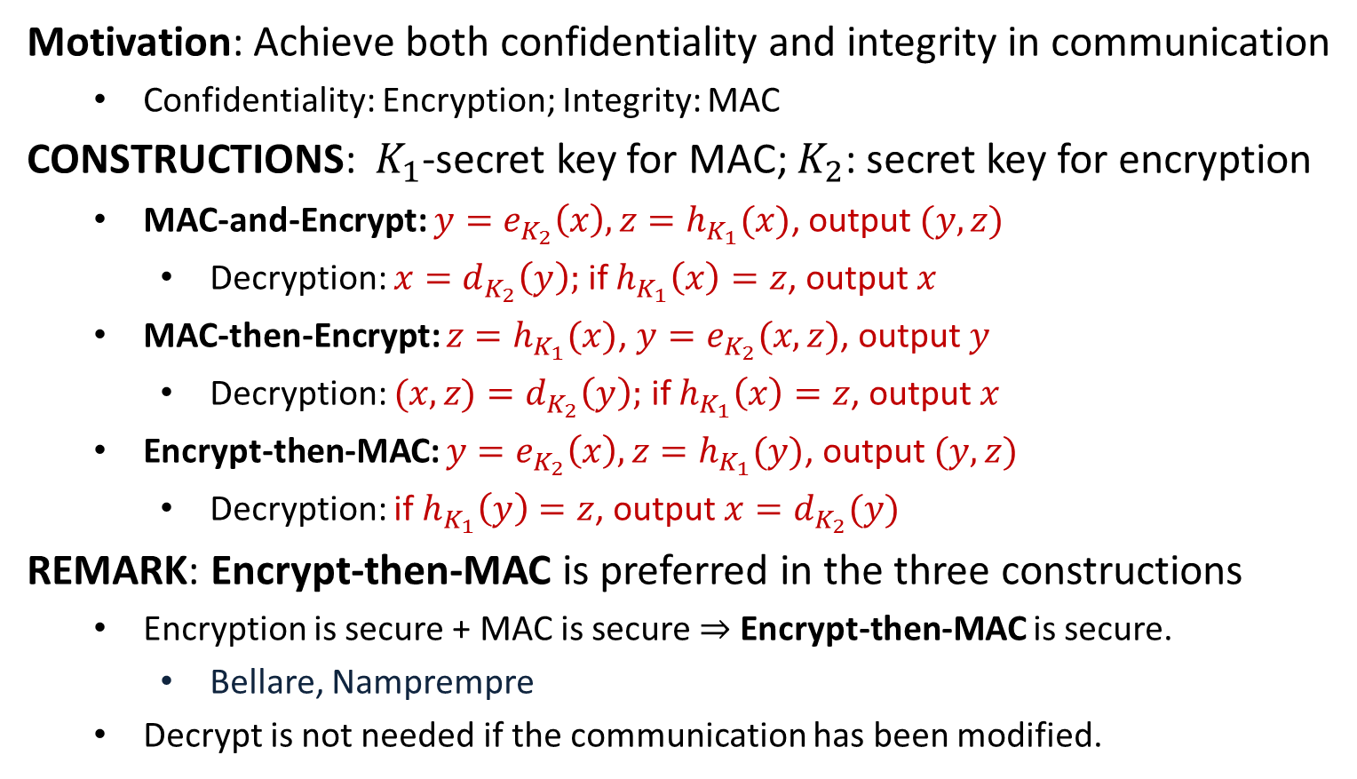
Authenticated Encryption
Motivation: Achieve both confidentiality and integrity in communication
Confidentiality: Encryption; Integrity: MAC
CONSTRUCTIONS: $K_{1}$-secret key for MAC; $K_{2}$: secret key for encryption
MAC-and-Encrypt: $y=e_{K_{2}}\left(x\right), z=h_{K_{1}}(x)$, output $(y,z)$
Decryption: $x=d_{K_{2}}\left(y\right);$ if $h_{K_{1}}\left(x\right)=z$, output $x$
MAC-then-Encrypt: $z=h_{K_{1}}(x)$, $y=e_{K_{2}}(x,z)$, output $y$
Decryption: $(x,z)=d_{K_{2}}\left(y\right);$ if $h_{K_{1}}\left(x\right)=z$, output $x$
Encrypt-then-MAC: $y=e_{K_{2}}\left(x\right), z=h_{K_{1}}(y)$, output $(y,z)$
Decryption: if $h_{K_{1}}\left(y\right)=z$, output $x=d_{K_{2}}(y)$
REMARK: Encrypt-then-MAC is preferred in the three constructions
Encryption is secure + MAC is secure $⇒$ Encrypt-then-MAC is secure.
Bellare, Namprempre
Decrypt is not needed if the communication has been modified.

Slide 12



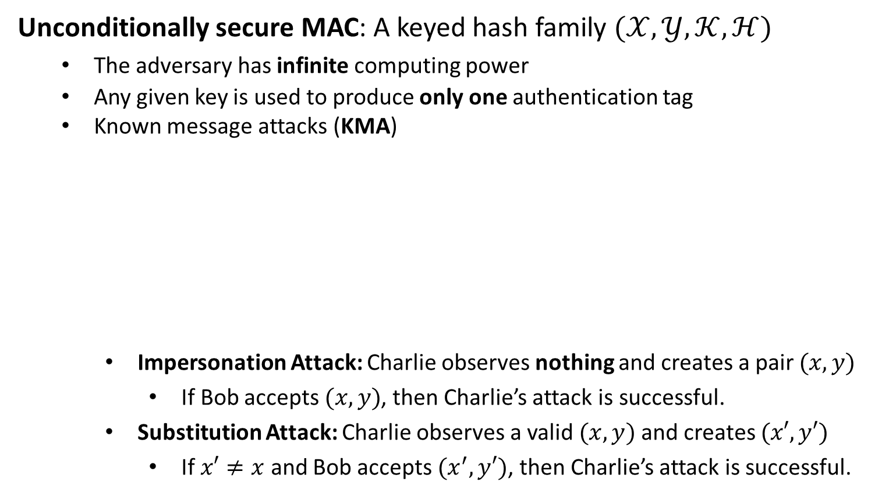


Unconditionally Secure MACs
Unconditionally secure MAC: A keyed hash family $(𝒳,𝒴,𝒦,ℋ)$
The adversary has infinite computing power
Any given key is used to produce only one authentication tag
Known message attacks (KMA)
Impersonation Attack: Charlie observes nothing and creates a pair $(x,y)$
If Bob accepts $(x,y)$, then Charlie’s attack is successful.
Substitution Attack: Charlie observes a valid $(x,y)$ and creates $(x′,y′)$
If $x′≠x$ and Bob accepts $(x^{′},y′)$, then Charlie’s attack is successful.
$$x, y=h_{K}(x)$$
Alice
Bob
$$K$$
$$K$$
Charlie

Slide 13
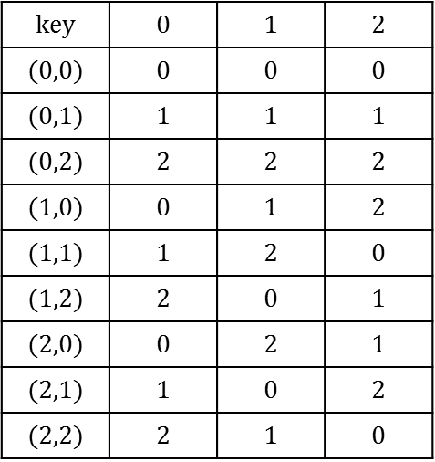
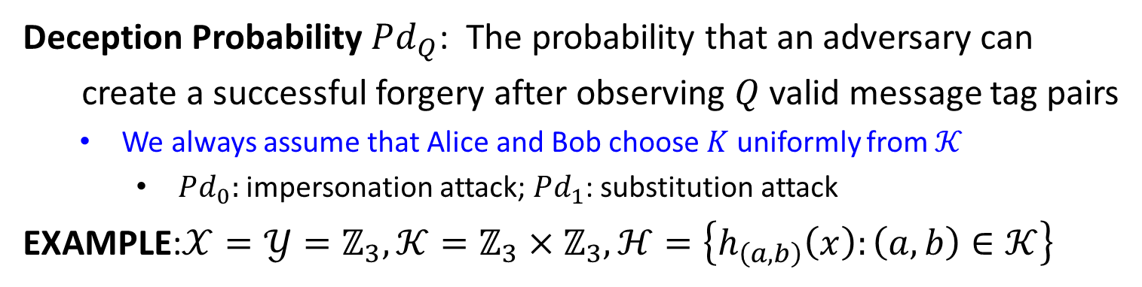
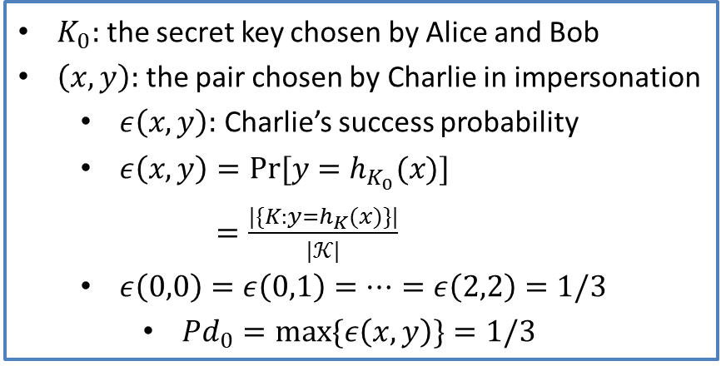
Unconditionally Secure MACs
Deception Probability $Pd_{Q}$: The probability that an adversary can
create a successful forgery after observing $Q$ valid message tag pairs
We always assume that Alice and Bob choose $K$ uniformly from $𝒦$
$Pd_{0}:$ impersonation attack; $Pd_{1}$: substitution attack
EXAMPLE:$𝒳=𝒴=ℤ_{3},𝒦=ℤ_{3}×ℤ_{3},ℋ=\left\{h_{\left(a,b\right)}\left(x\right):\left(a,b\right)∈𝒦\right\}$
$$key$$ | $$0$$ | $$1$$ | $$2$$
$$(0,0)$$ | $$0$$ | $$0$$ | $$0$$
$$(0,1)$$ | $$1$$ | $$1$$ | $$1$$
$$(0,2)$$ | $$2$$ | $$2$$ | $$2$$
$$(1,0)$$ | $$0$$ | $$1$$ | $$2$$
$$(1,1)$$ | $$1$$ | $$2$$ | $$0$$
$$(1,2)$$ | $$2$$ | $$0$$ | $$1$$
$$(2,0)$$ | $$0$$ | $$2$$ | $$1$$
$$(2,1)$$ | $$1$$ | $$0$$ | $$2$$
$$(2,2)$$ | $$2$$ | $$1$$ | $$0$$
$K_{0}:$ the secret key chosen by Alice and Bob
$\left(x,y\right):$ the pair chosen by Charlie in impersonation
$ε\left(x,y\right):$ Charlie’s success probability
$ε\left(x,y\right)=Pr⁡[y=h_{K_{0}}(x)]$
$=\frac{|\{K:y=h_{K}(x)\}|}{|𝒦|}$
$ε\left(0,0\right)=ε\left(0,1\right)=⋯=ε\left(2,2\right)=1/3$
$Pd_{0}=\max{\{ε\left(x,y\right)\}}=1/3$
Authentication Matrix

